Slide 1

Netflix Youtube Analisis

Slide 2

Greatest Hit
+ 160 M views
+ 2.5 M Likes

Slide 3
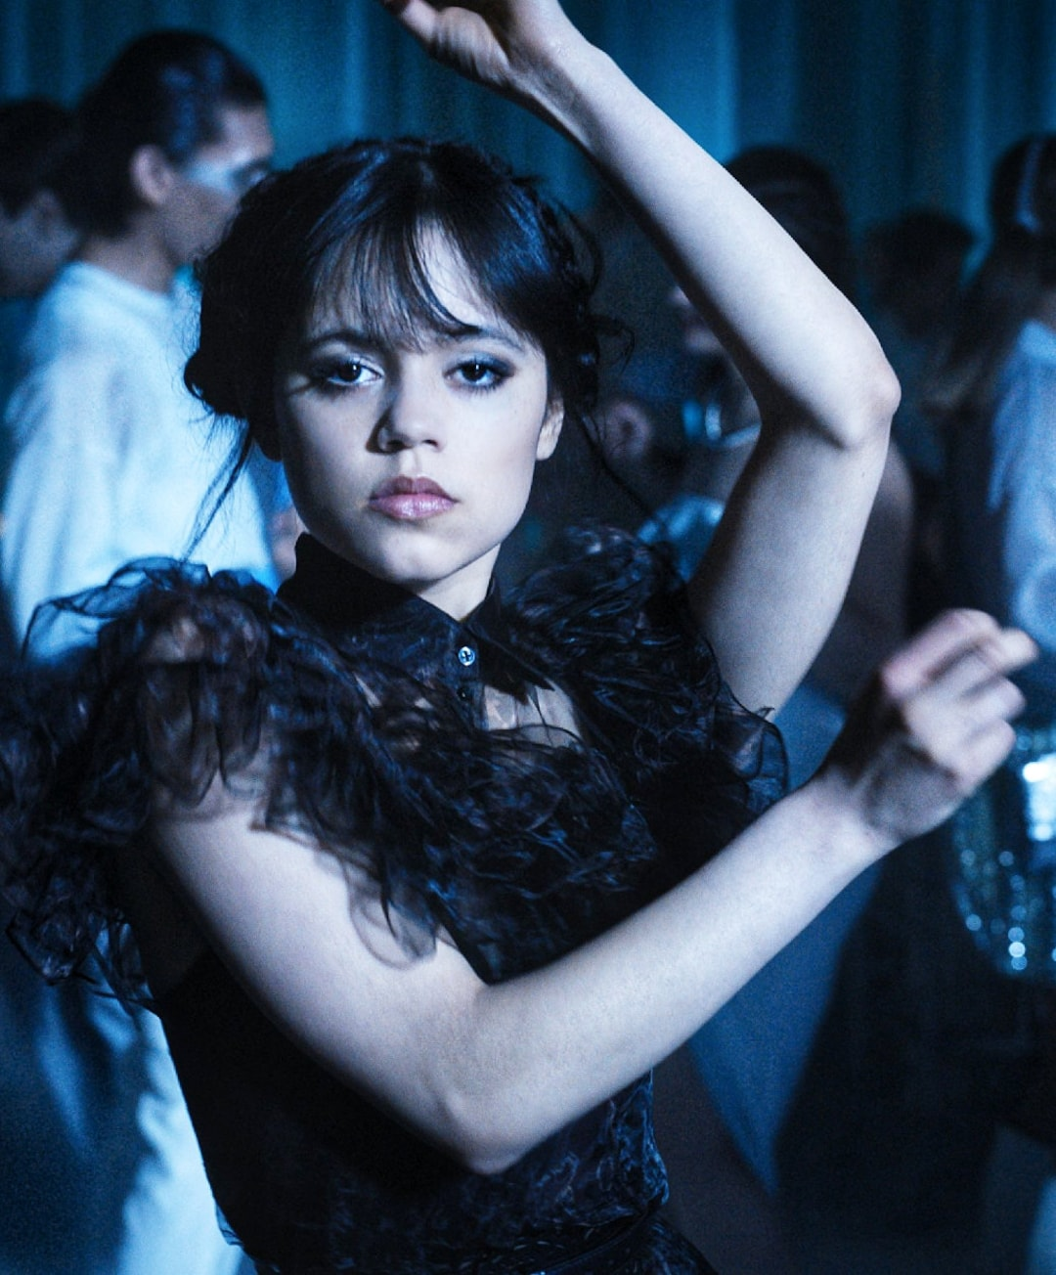

60 M Views dance scene

Slide 4
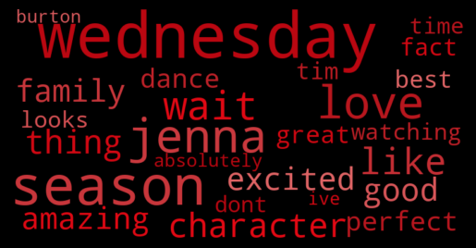
I love Jenna Ortega she is incredible, and she is the one to portray Wednesday…
Wednesday Comments

Slide 5
2,000M
35M
1.8M – 0.26 Score
All Videos
Total views
Total Likes
Total Comments & Sentiment
*700 Videos Sample, Score (-1,1)

Slide 6
KPIs
Great Views
Low Interaction
The Target
Creating Traffic
Brand Awareness
1.6% L/V Ratio
0.08% C/V to Ratio
3.0% L/V Ratio
0.25% C/V Ratio

Slide 7
0 Comments
By Netflix

Slide 8
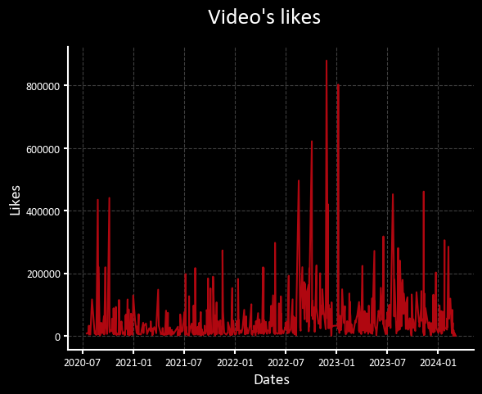
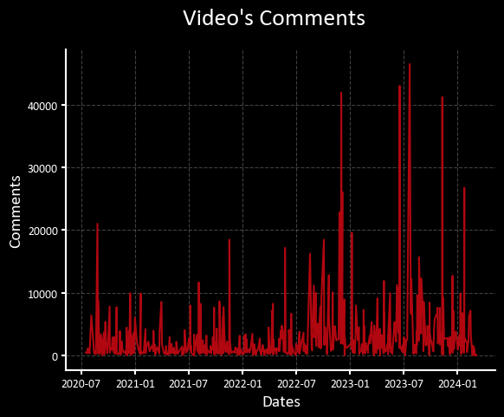
Temporal Analysis

Slide 9
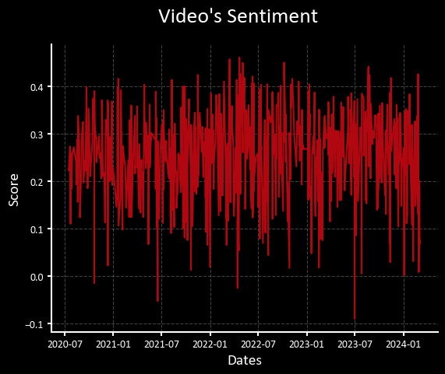
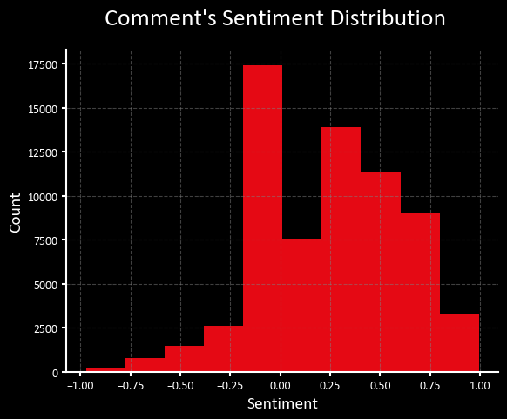
Sentiment Range

Slide 10
In Users’ Words…
Analyzing comments by words

Slide 11
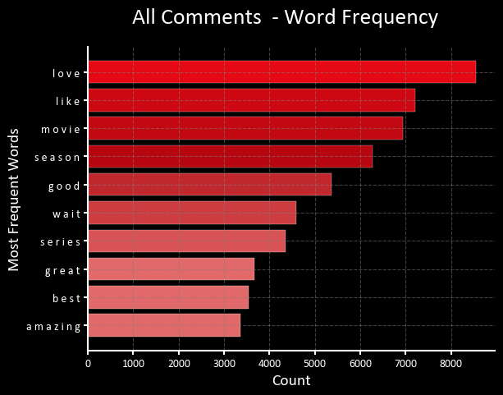

All Comments

Slide 12
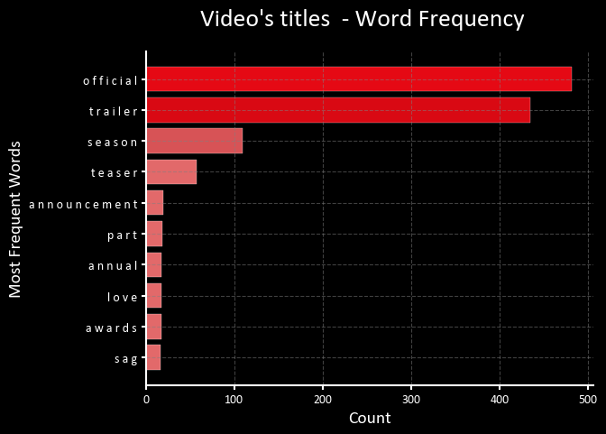
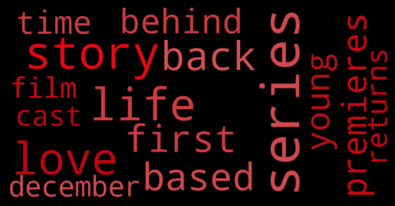
Netflix Words
Description Words

Slide 13
Best Videos
By Categories

Slide 14

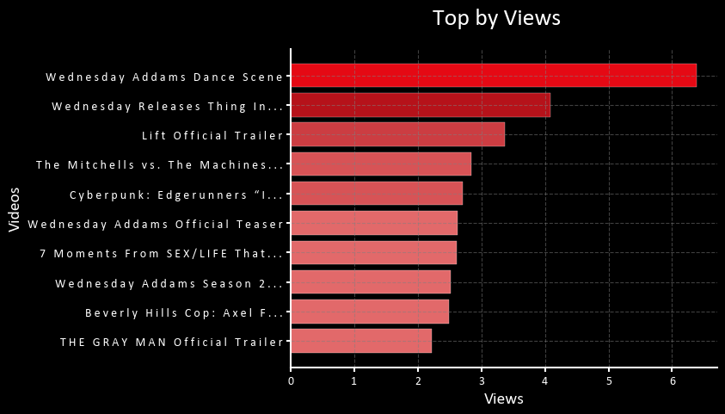


Ranking >> Views

Slide 15
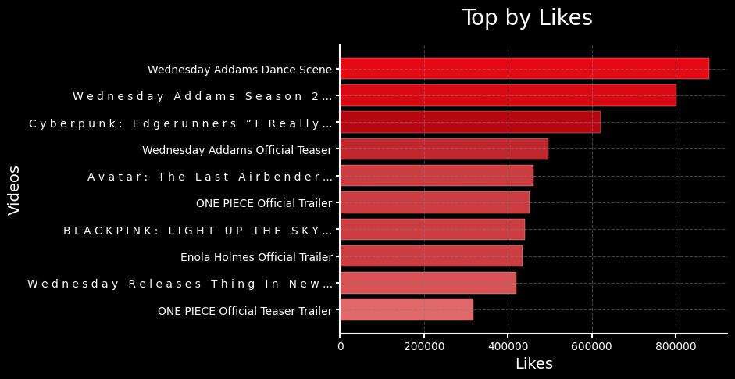


Ranking >> Likes

Slide 16
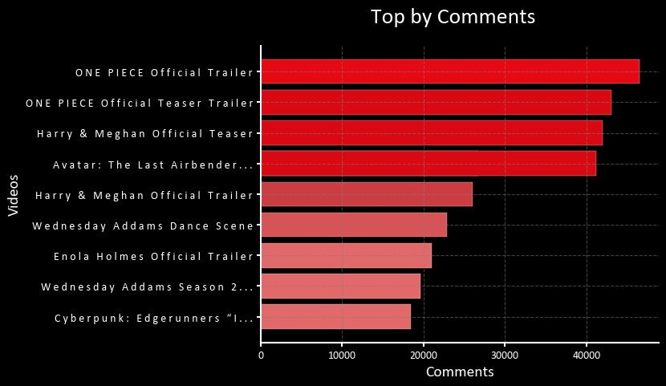

Ranking >> Comments

Slide 17

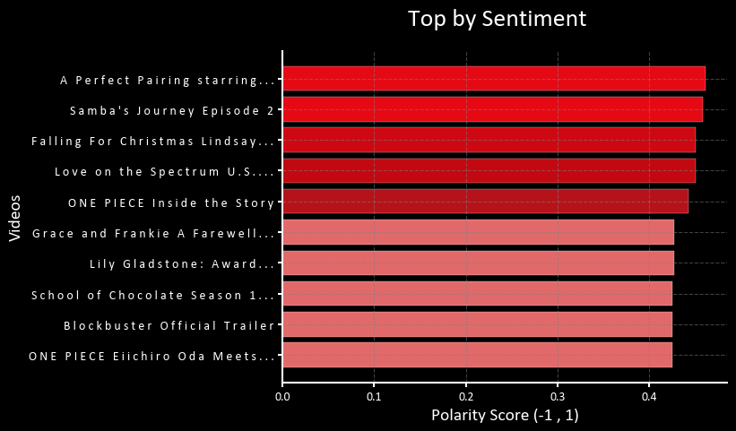


Ranking >> Sentiment

Slide 18

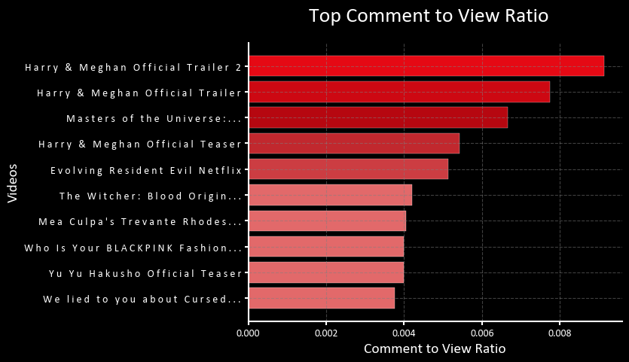
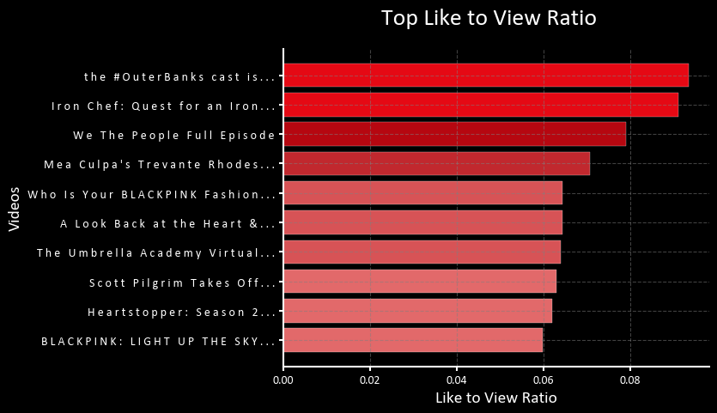

Ranking >> Ratios

Slide 19
SOLUTIONS
01
02
SOLUTION 1
SOLUTION 3
03
03
Engagement in comments key Videos to improve metrics.
Romantic shows & Realities are key to target consumers.
SOLUTION 4
SOLUTION 5
SOLUTION 6
Increase fundings in Top shows and top cast.d top cast.

Slide 20

THANKS!
Do you have any questions?
Jesus Lopez Neira

